Slide 1
The FT Web App and Automated Testing
Automated testing is good
Jim Cresswell (jim.cresswell@ft.com, @JimCresswell) Developer, FT Labs (@ftlabs)
Feb 2014
Notes:
I’m Jim Cresswell, I’m a developer working at the FT, currently focusing on automated test.
I’m going to talk a little bit about the FT, about FT Labs where I work, about testing and about the work we’ve done over the last 6 to improve our testing.

Slide 2
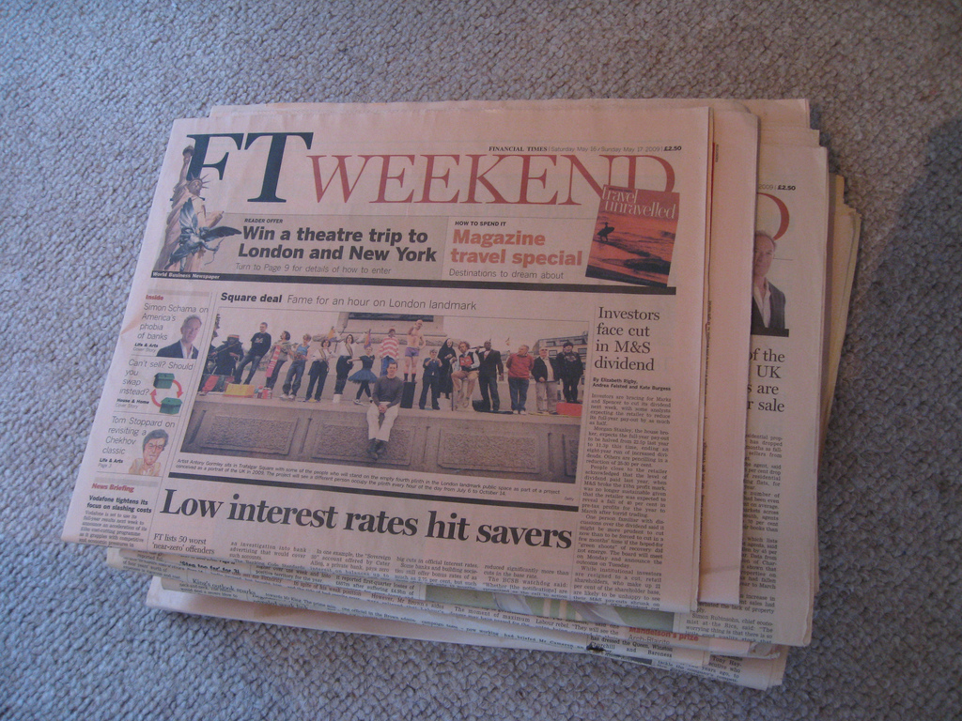
Notes:
The Financial Times is a newspaper.
It has an average daily global audience across media of more than two million people.

Slide 3

Welcome back to the web
The FT web app provides a touch optimised user experience.
Notes:
The FT has a web app. It used to look like this.

Slide 4
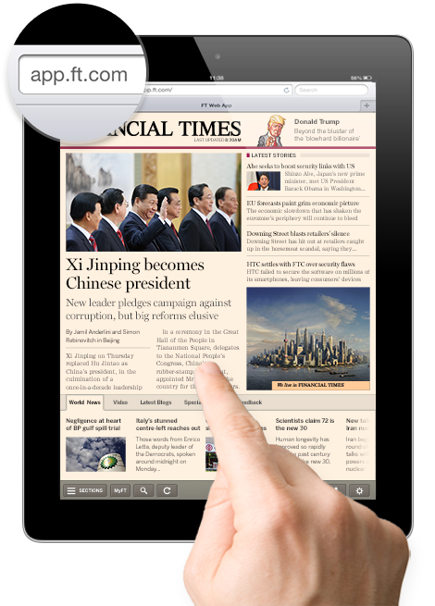
Notes:
And now it looks more like this.
What is a web app? It’s an app that is built with web technologies, if anyone wants to discuss that more let’s leave it until questions.

Slide 5
app.ft.com– same code everywhere.
Notes:
Why a web app? The web app code is cross platform, the same code base powers all the versions of the app.

Slide 6
app.ft.com– same code everywhere
Main platforms
iOS - iPhone and iPad – fullscreen web app
Android - thin native wrapper
Windows 8 – thin HTML5 wrapper
Beta platforms
Most modern mobile and desktop browsers
Notes:
This doesn’t solve every problem and presents a few, but it was a good fit for our needs.
Our main platforms are iOS, Android and Windows 8. If you type app.ft.com into a browser there is a good chance it will work.

Slide 7
FT Labs labs.ft.com github.com/ftlabs @ftlabs
Notes:
For some context:
The app is created by FT Labs, a web research and development group within the FT.

Slide 8
FT online numbers
The FT app has over 4 million users [subscribers and anonymous].
“[Digital] subscribers increasing 24% year on year to almost 387,000.”
“Mobile devices now generate 60% of [digital] subscriber consumption, 40% of total traffic and a quarter of new digital subscriptions.”
Notes:
There is free content on ft.com and in the app but it is largely a paid subscription service.
Digital use is being driven by mobile. “Mobile devices” does include a small amount of traffic on m.ft.com but largely“mobile” means “the app”.

Slide 9
FT app architecture
Offline capable Javascript/HTML/CSS front end, which talks to…
Largely PHP backend, which talks to…
FT content infrastructure.
Git, Github Enterprise, Jenkins.
Notes:
Very roughly the app architecture is…
To give you some idea of scale we have over 1100 files in the front end architecture alone.

Slide 10
How do we stop it from breaking? Testing Testing is good
Notes:
There are lots of types of testing.
There are lots of types of testing I’m not going to talk about, security testing, performance testing, stress testing.
Generally unless I specify manual tests I am talking about automated tests.
I’m talking here about software quality testing, and with a particular focus on testing the functionality of the product – is the product doing what it is supposed to do, but with a focus on letting developers know when they have broken things as quickly as possible.
So how much of what type of testing should we do?

Slide 11
The software testing pyramid
Notes:
A very broad brush answer is “take a look at the software testing pyramid”.

Slide 12
Test Pyramid
Manual
Testing
Functional (GUI) Testing
Integration Testing
Unit Testing
Notes:
There are plenty of version of this.
The general idea is that you should do more of the faster to execute and cheaper to maintain automated unit testing and less of the slow to execute and quite probably more expensive to maintain manual testing with some amount of automated system-y testing in between.

Slide 13
What happens when you retrofit automated testing to a project?
Notes:
That’s one persons idea of an ideal, but what happens if you have been largely relying on manual testing with a few automated tests and suddenly someone decides that automation is cool now?
You get…

Slide 14
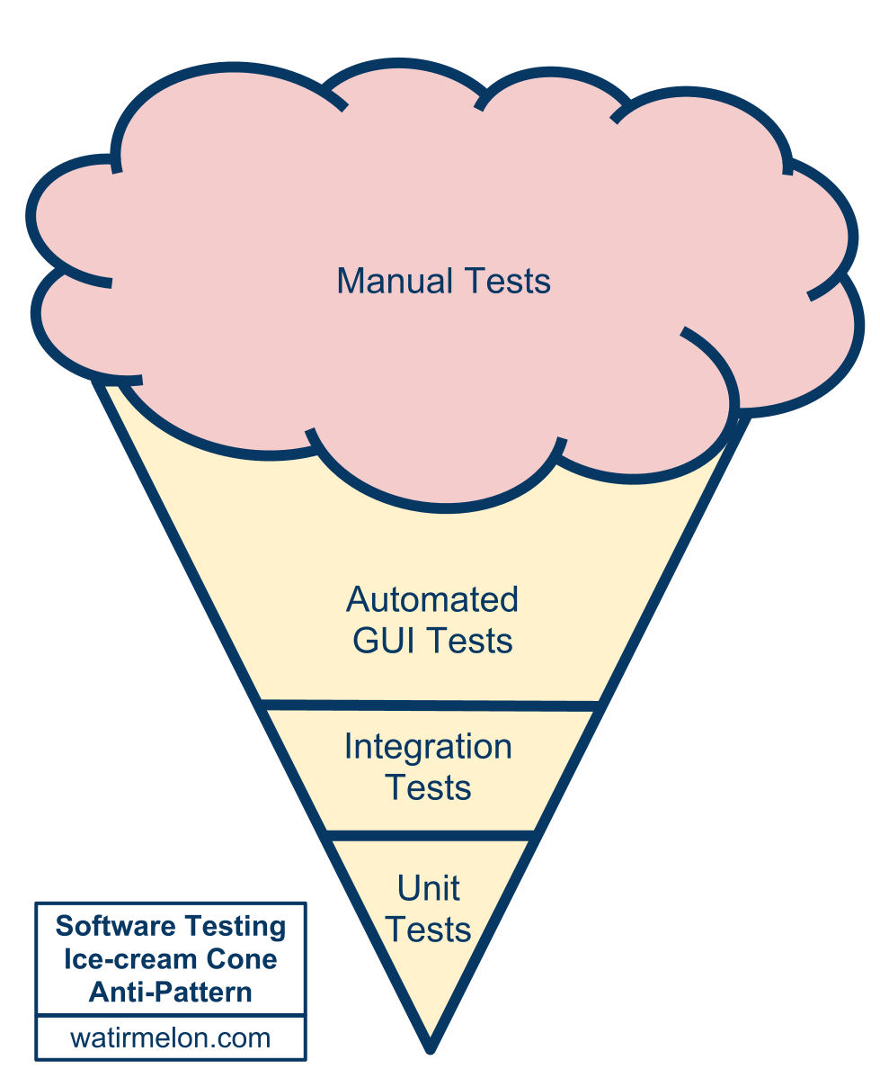
Test Ice-cream
Source:
Alister Scott
http://tiny.cc/testing-pyramid
Notes:
The test ice-cream!
A beautiful cloud of manual testing, with some manual test that have been automated, a few software level tests thrown in their by the enthusiastic and some perhaps unit tests written by rebellious dreamers. Credit to Alister Scott for either coming up with or reporting the ice-cream metaphor.
This arrangement is somewhat costly to maintain, somewhat slow to run, but a hell of a lot better than no automated tests at all, so if you have reached this point, good work! But you can go further.
For the FT app we actually have two test groups, the first one in house, and then a second stage at the FT main office which is effectively user acceptance testing which consists of further manual testing and automated testing or UAT with a visual regression test tool called Eggplant. My focus is on the testing that happens before the product gets to the UAT stage, my main goal is to support developers and bore the UAT team.

Slide 15
What are the point of tests?
Notes:
So what are the point of tests? From my current perspective I think there are broadly three points.

Slide 16
What are the point of tests?
To speed up and aid in code design and refactoring (unit tests).
To give fast feedback to developers - flag problems while the developer is still thinking about the task.
Making sure the product isn’t broken (user acceptance testers should be bored (not really!)).
Notes:
Code design, fest developer feedback and broad regression testing.
The first one I would say is up to developers as it’s largely an implementation methodology. I’m more focused on the second two.
This is what I think today, I don’t guarantee I will still think this tomorrow.
I’m not really trying to bore any manual testers. They should be given the kind of exploratory, intuitive, feeling based testing that only a human can do, because if your product has an API or a user interface then it’s humans that you are building for and humans that you want to keep happy.

Slide 17
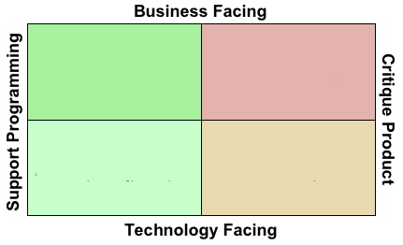
Testing quadrangle
Source: Brian Marick
http://www.exampler.com/old-blog/2003/08/21/#agile-testing-project-1
Notes:
For comparison here is a more general expression of what testing can be for, which perhaps covers aspects of testing which are not my immediate priorities at Labs, is the test quadrangle, first suggested by Brian Marick.
Testing can support code design and refactoring and it can support critiquing the product. It can also test business requirements and technology or code requirements. I’d say that what we’ve done at Labs over the last 6 months has at least touched all those quadrants. For the physicists in the audience, I don’t think this is really an orthogonal basis set.

Slide 18
Where were we 6 months ago?
Notes:
So where were we 6 months ago?

Slide 19
Where were we 6 months ago?
Lots of manual testing.
No automated functional tests.
Quite a few automated integration-unitish tests.

Slide 20
Where are we today?
Notes:
And how far have we come?

Slide 21
Where are we today?
Lots of manual testing – but finding many fewer issues and less serious issues.
Lots of automated functional tests.
Lots of automated integration (unitish) tests including…
JavaScript tests of required in modules – see http://github.com/ftlabs
Notes:
Manual tests – finding fewer issues, there is more time for exploratory testing and finding weird edge cases or asking questions like “how does the app feel?” – feeling is important, if the app feels sluggish or annoying in some ill defined way then users will put it down.
We have functional tests now, I will talk more about these in a moment.
Code tests – We have more than before, features are not considered complete until they are well tested. For those who are interested we use Phing and PHPUnit for PHP tests, Grunt and/or npm and buster.js for Javascript tests.

Slide 22
Functional testing
Notes:
As mentioned, a lot of the effort of the last 6 months has focused on creating a suite of automated functional tests.

Slide 23
Functional testing
Webdriver http://docs.seleniumhq.org/projects/webdriver/
Test in browsers, most of the problems we used to catch manually were cross-platform.
Tests are written in Java but could have been most languages.
Notes:
The functional tests use Webdriver, also known as Selenium 2, to exercise the app via its user interface and make sure things are as expected. Webdriver is a wonderful thing and I have linked to the docs in the slide.
We test in the browser, partially because most of the problems we find either manually or with automated tests are cross-platform, and partially because testing a web app or hybrid app on a device is hard – more about our aspirations in this area later.
The tests are written in Java but could just as easily have been written in JavaScript or Ruby or Python or even Perl. Java was chosen because that is the default implementation and tends to get the latest features first.

Slide 24
When do we test?
Notes:
Actually one of the biggest things we have achieved in the last 6 months is changing when we run tests…

Slide 25
When do we test?
Before a commit is merged into the main branch.
When the main branch changes, and periodically outside working hours.
Hourly against the live product.
Notes:
Three main points of test.
Before a commit is merged into the main branch. If you aren’t familiar with version control of software the important point is that before we merge developer code into the main version of the code we make sure that the new code resulting from the merge would pass all the tests. We never merge code that would “break the build” – this prevents broken code form holding up others developers from merging the code they are working on. If you are familiar with version control and a github style workflow we test the potential merge product of pull-requests before accepting the request.
Whenever a change is merged to the main branch and at least hourly – partially to catch issues with infrastructure that were not caused by code changes.
And, on the basis that there is no fundamental difference between testing and monitoring we also run the functional tests against live.

Slide 26
Where do we want to go?

Slide 27
Where do we want to go?
Continuous delivery – removing artificial blocking relationships between features.
Parallel testing on many devices.
A set of super fast code tests that runs whenever a developer hits save.
Total regression coverage, never hear about a problem from an external source twice.
Notes:
Continuous delivery
Tooling for testing web apps and hybrid apps is appearing, appium, ios-driver, selendroid.
On save testing easy enough with task running software, e.g. Grunt for JS development.

Slide 28
Summary

Slide 29
Summary
Testing is good.
Automate what you can automate (without going nuts).
Pyramids are better than ice-cream,
Manual testers should never be bored, give them the interesting stuff that a computer just can’t do.
Notes:
Testing is good. You probably new that, but I think it helps to keep saying it.
Automation is generally good. Consider the longer term repercussions of automation, is it going to save you time this week, month, year, is it going to mean you never break the same thing twice? Probably.
People (and manual testers are people) can things that computers can’t, especially when it comes to deciding what will annoy other people.
Has it been worth it? Yes! We find far fewer problems now, the problems we find are less serious, or more subtle, we can focus on a level of quality that we couldn’t before. It’s been 6 months since we got a call from the UAT testers telling us that the app doesn’t load.

Slide 30
Reading and resources
Open source libraries http://github.com/ftlabs
Tutorials and articles http://labs.ft.com
On device GUI testing (web/hybrid/native) http://appium.io/ http://ios-driver.github.io/ios-driver/ http://selendroid.io/
Notes:
Here’s a few links you might find interesting. The FT Labs open source libraries are on Github. There are some tutorials and articles on the labs website. And for anyone interested in testing web and hybrid apps (and in the case of Appium, native apps) here are some links to projects which are attempting to enable that.

Slide 31
Thanks!
Jim Cresswell
jim.cresswell@ft.com, @JimCresswell
Sound like fun?
labs.ft.com/jobs
Notes:
So, thanks for listening.
If anyone is curious as to what the functional tests look like in action find me afterwards and I can give you a demo on my laptop.
And, if you are a test automation engineer and you want to move to London let me know.

